Slide 1
Creating A Generic Repository
in .NET Core w/ Entity Framework Core 2

Slide 2

Clayton Hunt
Meetup: Co-founder St.Pete .Net Meetup
Blogs: 6figureDev.com,
ProgrammingFromScratch.com
Twitter: @ClaytonHunt_104
Author: Practical Test-Driven Development using C# 7

Slide 3


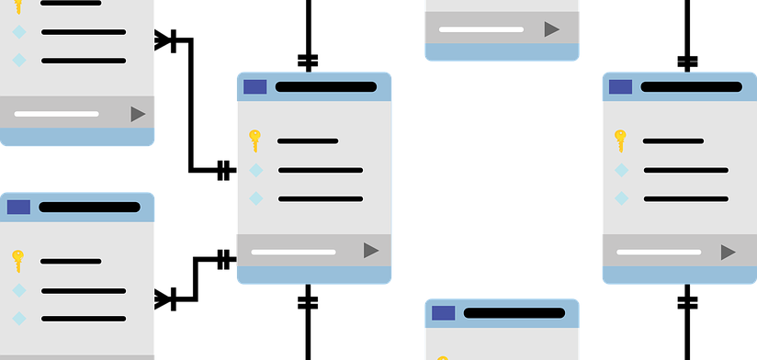
Where do you start when building an App
User Interface
Business Logic
Database
Interactions
What is seen
Use Cases
Rules
Models
Schema

Slide 4
An Application With Complex Needs
A Payroll Application
Employees
Commissioned
Salaried
Hourly
Reports
All Employees
Per Employee

Slide 5
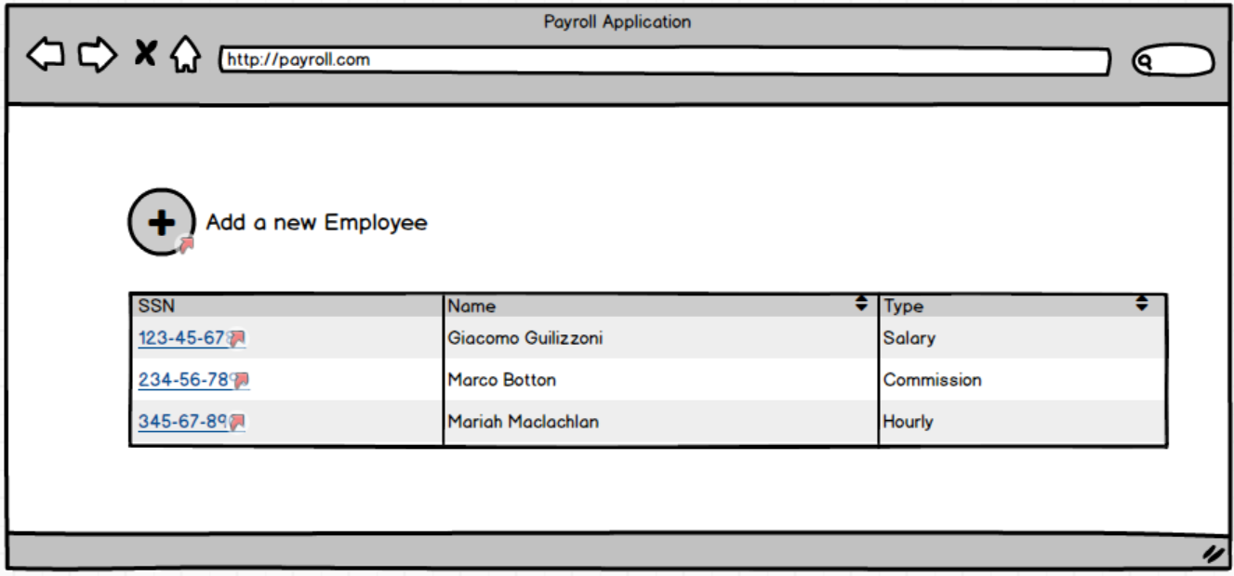
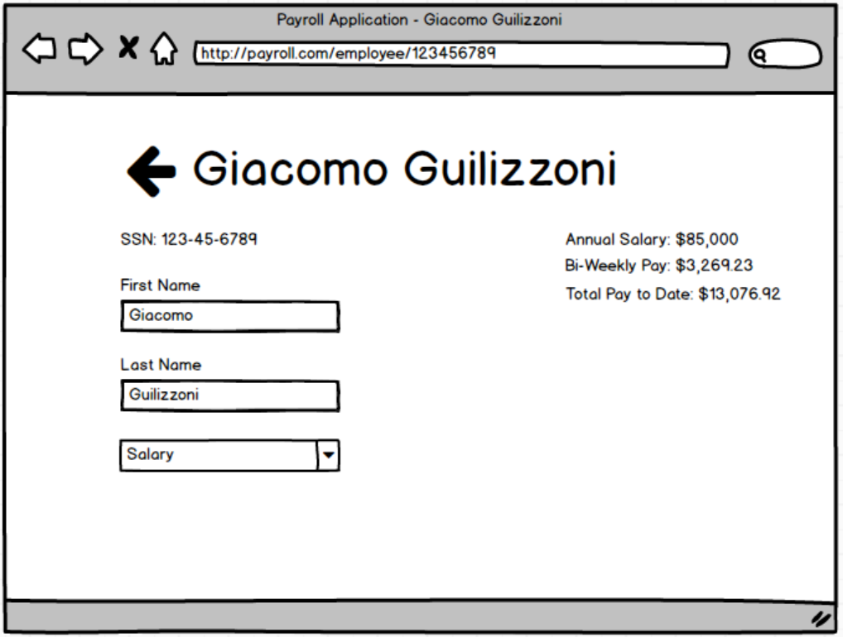
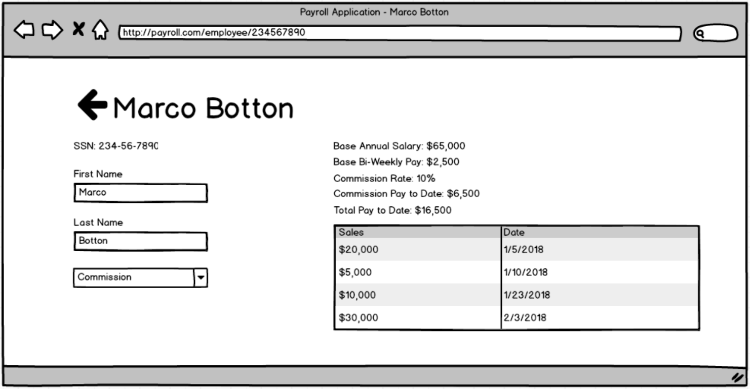
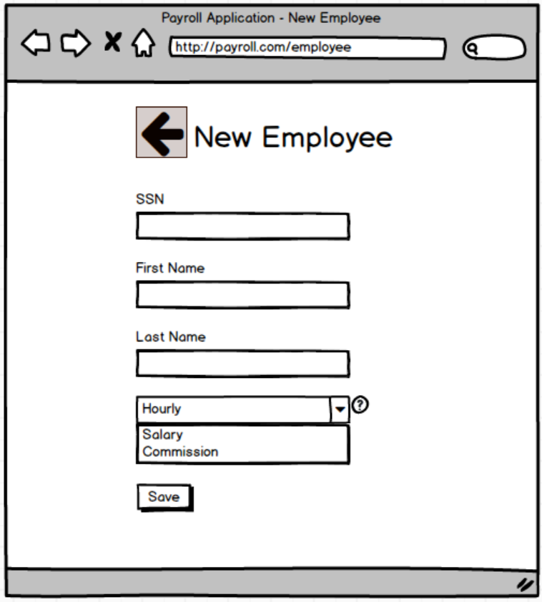
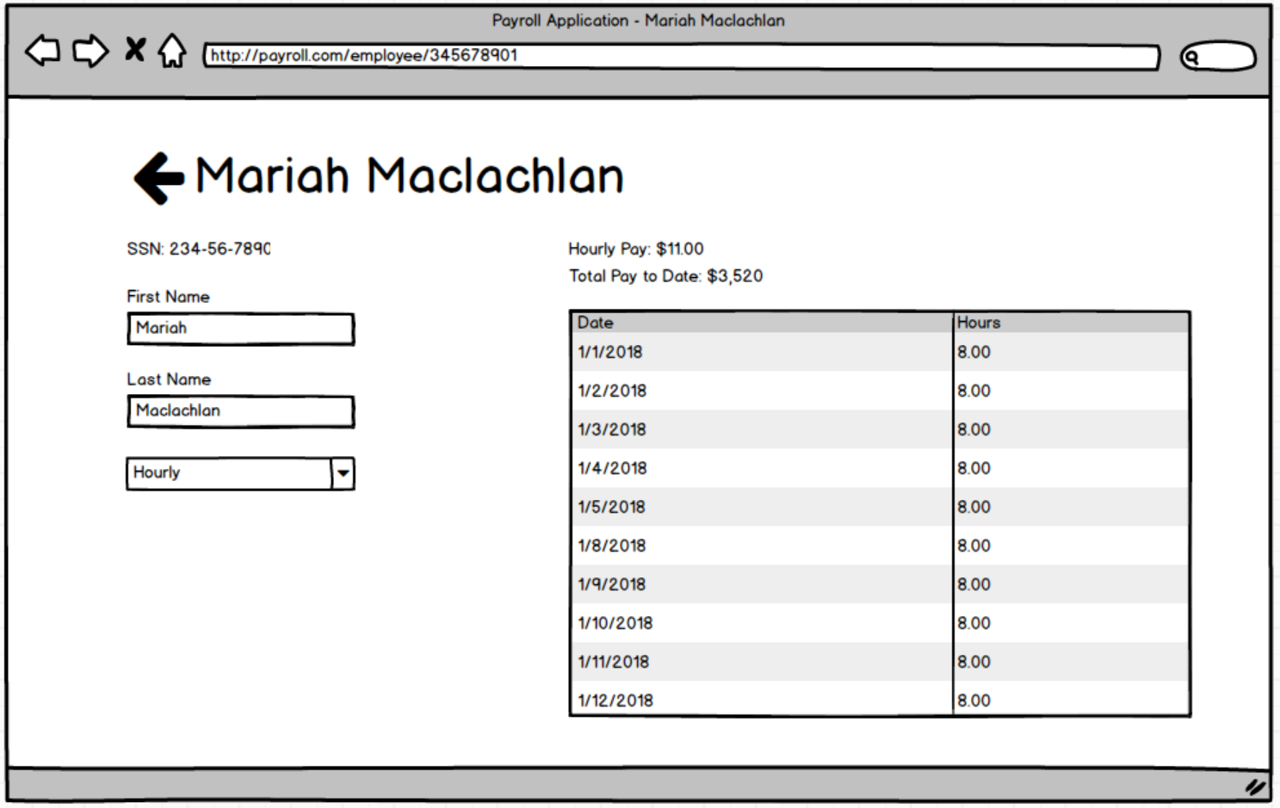
User Interface
A web application with pages for reporting on overall employee payroll and individual employee payroll

Slide 6
Business Cases
USE CASE 1: ADD NEW EMPLOYEE A new employee is added by the receipt of an AddEmp transaction. This transaction contains the employee's name, address, and assigned employee number. The transaction has the following three forms: AddEmp [EmpID] "[name]" "[address]" H [hourly-rate] AddEmp [EmpID] "[name]" "[address]" S [monthly-salary] AddEmp [EmpID] "[name]" "[address]" C [monthly-salary] [commission-rate] The employee record is created with its fields assigned appropriately. Alternative: An error in the transaction structure If the transaction structure is inappropriate, it is printed out in an error message, and no action is taken.
This involves quite a bit of conversation and is difficult to represent in a few pictographs.

Slide 7
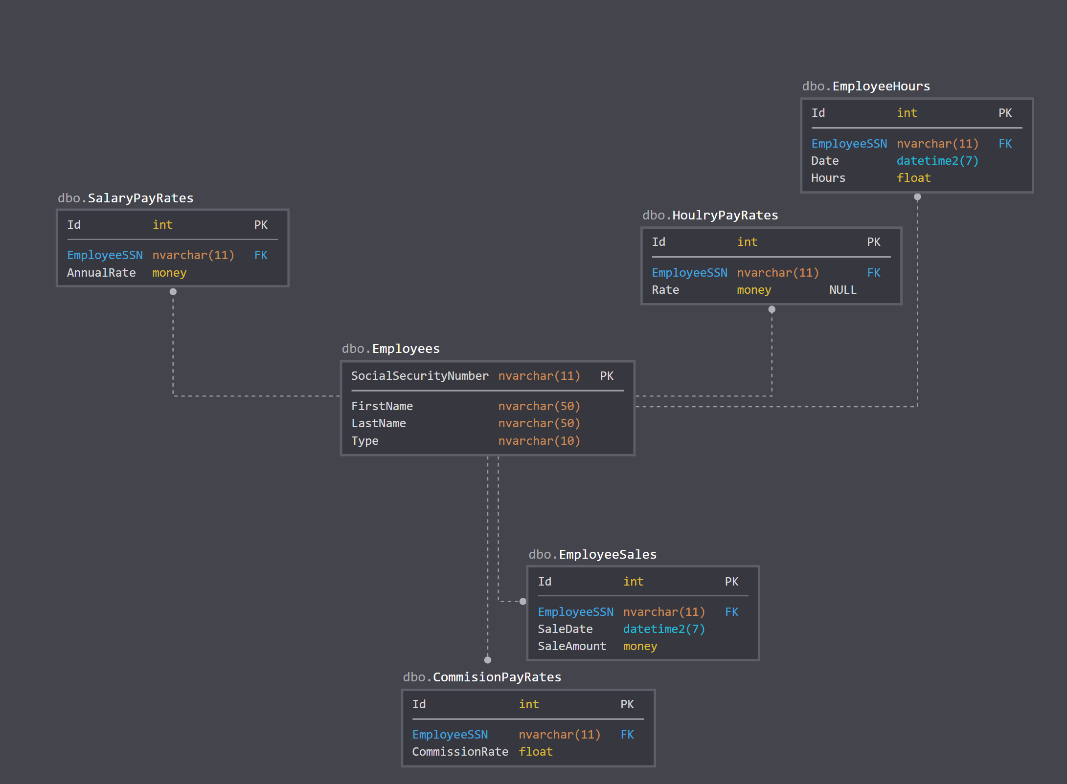
Database
A MS SQL Database created using Entity Framework Core and Migrations

Slide 8
The Tools We Will Use
.Net Core
EntityFramework Core
MVC (Model View Controller)
Razor Templating Engine

Slide 9
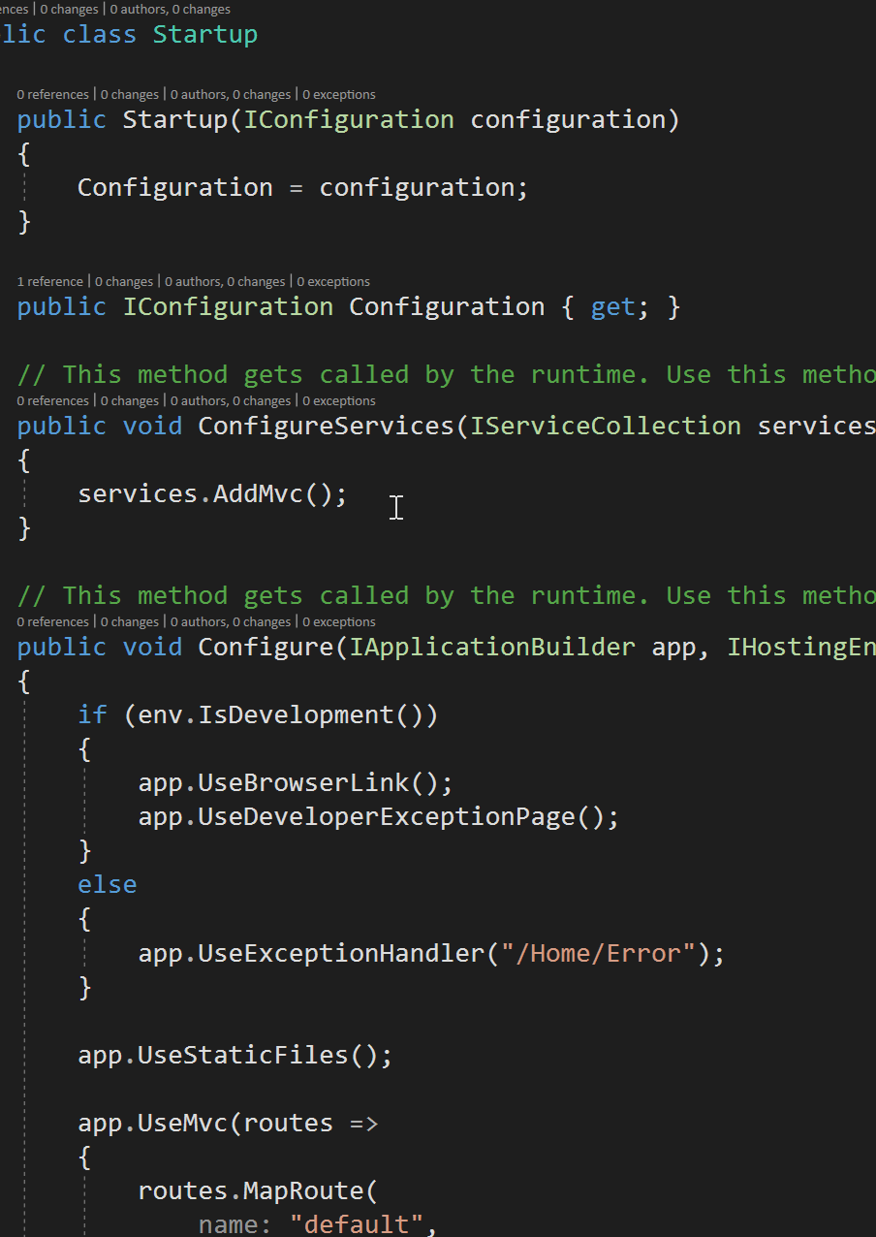
Lets look at Some code
Lets look at how most demos might have you write the code.
Extension methods cannot be dynamically dispatched.

Slide 10
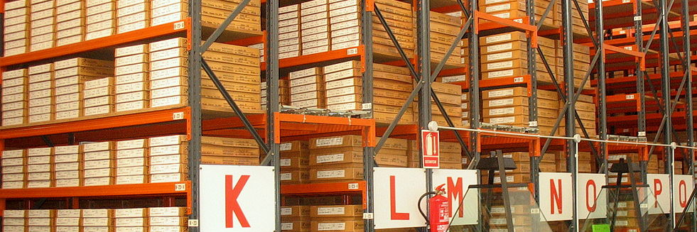
Patterns that Can Help
We can make use of the Repository and Mapper/Adapter patterns to make development faster and less error prone

Slide 11
What is The Repository Pattern? In short, it’s create, read, update, and delete
A system with a complex domain model often benefits from a layer, such as the one provided by Data Mapper (165), that isolates domain objects from details of the database access code. In such systems it can be worthwhile to build another layer of abstraction over the mapping layer where query construction code is concentrated. This becomes more important when there are a large number of domain classes or heavy querying. In these cases particularly, adding this layer helps minimize duplicate query logic.
A Repository mediates between the domain and data mapping layers, acting like an in-memory domain object collection. Client objects construct query specifications declaratively and submit them to Repository for satisfaction. Objects can be added to and removed from the Repository, as they can from a simple collection of objects, and the mapping code encapsulated by the Repository will carry out the appropriate operations behind the scenes. Conceptually, a Repository encapsulates the set of objects persisted in a data store and the operations performed over them, providing a more object-oriented view of the persistence layer. Repository also supports the objective of achieving a clean separation and one-way dependency between the domain and data mapping layers.
https://martinfowler.com/eaaCatalog/repository.html

Slide 12
What is the Mapper/Adapter Pattern? In short it converts one object to another
Sometimes you need to set up communications between two subsystems that still need to stay ignorant of each other. This may be because you can't modify them or you can but you don't want to create dependencies between the two or even between them and the isolating element.
https://martinfowler.com/eaaCatalog/mapper.html

Slide 13


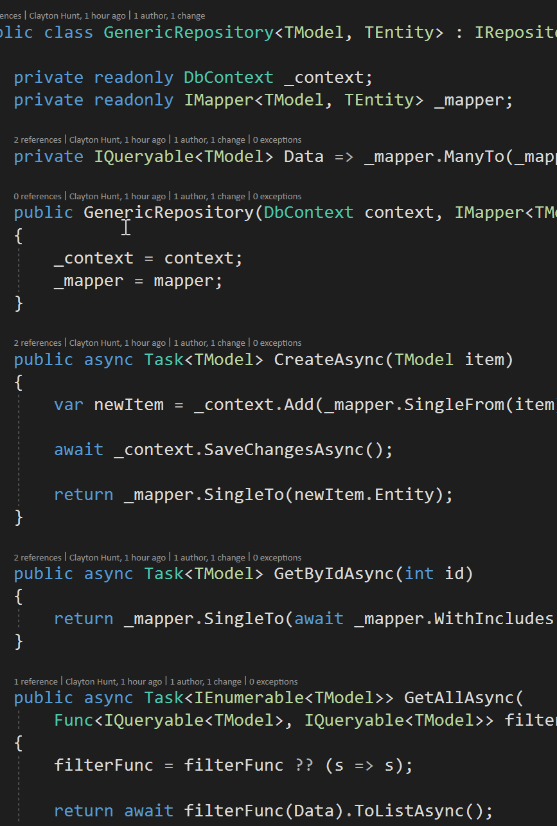
Lets Look At More Code
The Repository and Mappers. First the complete example and secondly we will create a simpler example and show how that can be wired up.

Slide 14
Clayton Hunt
Meetup: Co-founder St.Pete .Net Meetup
Blogs: 6figureDev.com,
ProgrammingFromScratch.com
Twitter: @ClaytonHunt_104
Author: Practical Test-Driven Development using C# 7

